Slide 1
Advanced Data Mining
Introduction to Data Mining

Slide 2
Data Mining & Data Science
The terms “data science” and “data mining” often are used interchangeably, and the former has taken a life of its own as various individuals and organizations try to capitalize on the current hype surrounding it.
At a high level, data science is a set of fundamental principles that guide the extraction of knowledge from data.
Data mining is the extraction of knowledge from data, via technologies that incorporate these principles.
As a term, “data science” often is applied more broadly than the traditional use of “data mining,” but data mining techniques provide some of the clearest illustrations of the principles of data science.

Slide 3
Data Mining & Data Science
It is important to understand data science even if you never intend to apply it yourself.
Data-analytic thinking enables you to evaluate proposals for data mining projects.
For example, if an employee, a consultant, or a potential investment target proposes to improve a particular business application by extracting knowledge from data, you should be able to assess the proposal systematically and decide whether it is sound or flawed.
…. you should be able to spot obvious flaws, unrealistic assumptions, and missing pieces.

Slide 4
Defining Data Mining
Data Mining has been defined as
Similar terms
Exploratory data analysis
Data driven discovery
Deductive learning
Discovery Science
Knowledge Discovery
“The nontrivial extraction of implicit, previously unknown, and potentially useful information from data”.
(Frawley et al. , 1992)

Slide 5

Example
How do politicians use Facebook?

Slide 6
What roughly do we need to do?
Get some data: Facebook posts / comments in this case
Then we need to organise the data somehow
e.g. by language, political party, temporal aspects, etc.
Identify the subset of data that we actually need
E.g. if we are only interested in Irish politicians, we exclude German politicians
E.g. if we only want to assess politician posts, we can ignore audience comments
Etc.
Then we need to prepare (pre-process) the data for analysis
E.g. remove superfluous posts, handle emoji/emoticons
Having pre-processed the data, we may need to change its representation (transform the data) to make it easier to analyse
For FB data, this may mean some form of text processing, deriving some summarisation values (e.g. no. of posts, reactions, comments) etc. that are appropriate to our question
Analyse the data
Interpret the results

Slide 7
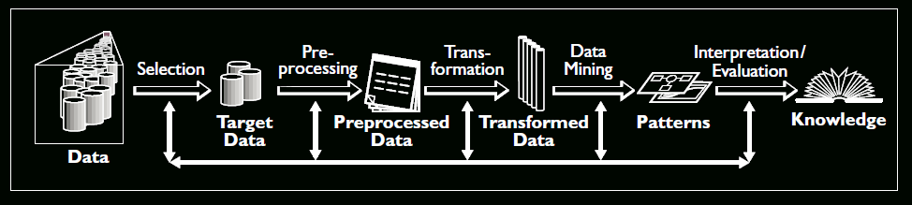
KDD
Data mining is also called knowledge discovery and data mining (KDD)
Data mining is
extraction of useful structured patterns from data sources, e.g., databases, texts, web, images.
Patterns must be:
valid, novel, potentially useful, understandable
KDD is often applied interactively and iteratively.
(Brachman and Anand, 1996; Fayyad, 1996; Fayyad et al., 1996)

Slide 8
KDD
Selection
This stage consists on creating a target data set, or focusing on a subset of variables or data samples, on which discovery is to be performed.
Pre processing
This stage consists on the target data cleaning and pre processing in order to obtain consistent data.
Transformation
This stage consists on the transformation of the data using dimensionality reduction or transformation methods.
Data Mining
This stage consists on the searching for patterns of interest in a particular representational form, depending on the data mining objective (usually, prediction)
Interpretation/Evaluation
This stage consists on the interpretation and evaluation of the mined patterns.
(Fayyad et al., 1996)

Slide 9

How do politicians use Facebook?
Facebook: no dirty campaigns
We’re going to lose ☹
I tell the truth
We’re treated equally
I (re)present me, not my party
We’re most positive about the majority party
Study on 187 German Federal Politicians
55k posts (2M words), 230k comments (6.5M words), 1.5M likes
(Caton et al., 2015)

Slide 10
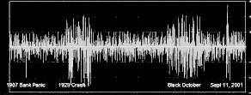
Architecture
REST API
Some programming language
Some programming language
Some DB Engine
Some connection
Some text analytics library

Slide 11
Architecture
This approach is pretty generalizable within the KDD framework (as well as other data mining methodologies)
Every single exercise in data mining should follow these (or similar) steps.
In ADM, we will go through this process over and over again, often with slight variations.

Slide 12
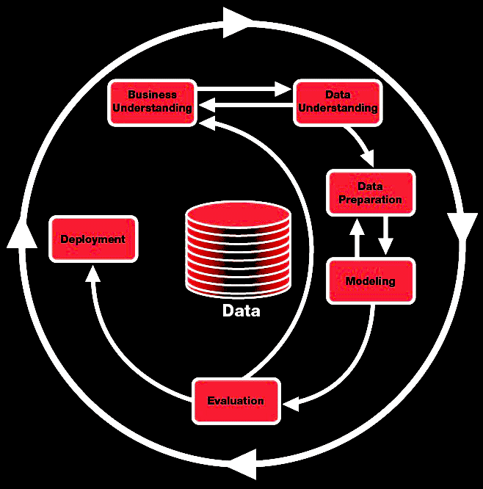
CRISP-DM: CRoss-Industry Standard Process for Data Mining

Slide 13
CRISP-DM
Business understanding
This initial phase focuses on understanding the project objectives and requirements from a business perspective, then converting this knowledge into a data mining problem definition and a preliminary plan designed to achieve the objectives.
Data understanding
The data understanding phase starts with an initial data collection and proceeds with activities in order to get familiar with the data, to identify data quality problems, to discover first insights into the data or to detect interesting subsets to form hypotheses for hidden information.
Data preparation
The data preparation phase covers all activities to construct the final dataset from the initial raw data.
Modeling
In this phase, various modeling techniques are selected and applied and their parameters are calibrated to optimal values.
Evaluation
At this stage the model (or models) obtained are more thoroughly evaluated and the steps executed to construct the model are reviewed to be certain it properly achieves the business objectives.
Deployment
Creation of the model is generally not the end of the project. Even if the purpose of the model is to increase knowledge of the data, the knowledge gained will need to be organized and presented in a way that the customer can use it.
(Chapman et al., 2000)

Slide 14
SEMMA
Pushed by SAS and often in conjunction with SAS tools
“SEMMA offers an easy to understand process, allowing an organized and adequate development and maintenance of DM projects. It thus confers a structure for his conception, creation and evolution, helping to present solutions to business problems as well as to find de DM business goals.”
It is independent of the data mining model(s) and techniques applied.
(Azevedo, 2008)

Slide 15
SEMMA
Sample
This stage consists on sampling the data by extracting a portion of a large data set big enough to contain the significant information, yet small enough to manipulate quickly. This stage is pointed out as being optional.
Explore
This stage consists on the exploration of the data by searching for unanticipated trends and anomalies in order to gain understanding and ideas.
Modify
This stage consists on the modification of the data by creating, selecting, and transforming the variables to focus the model selection process.
Model
This stage consists on modeling the data by allowing the software to search automatically for a combination of data that reliably predicts a desired outcome.
Assess
This stage consists on assessing the data by evaluating the usefulness and reliability of the findings from the data mining process and estimate how well it performs.
(Azevedo, 2008)

Slide 16
Comparing KDD, SEMMA and CRISP-DM
KDD | SEMMA | CRISP-DM
Pre KDD |  | Business Understanding
Selection | Sample | Data Understanding
Pre Processing | Explore
Transformation | Modify | Data Preparation
Data mining | Model | Modelling
Interpretation / Evaluation | Assessment | Evaluation
Post KDD |  | Deployment

Slide 17
Data Mining Models & Tasks
The Data Mining (KDD) Process
Understand the application domain
Identify data sources and select target data
Pre-process: cleaning, attribute selection
Data mining to extract patterns or models
Post-process: identifying interesting or useful patterns
Incorporate patterns in real world tasks
In practice, a critical skill in data science is the ability to decompose a data analytics problem into pieces such that each piece matches a known task for which tools are available.
Recognizing familiar problems and their solutions avoids wasting time and resources reinventing the wheel.
It also allows people to focus attention on more interesting parts of the process that require human involvement — parts that have not been automated, so human creativity and intelligence must come into play.

Slide 18
Supervised vs. Unsupervised Methods
Consider two similar questions we might ask about a customer population.
“Do our customers naturally fall into different groups?”
“Can we find groups of customers who have particularly high likelihoods of cancelling their service soon after their contracts expire?”
No specific purpose or target has been specified for the grouping.
When there is no such target, the data mining problem is referred to as unsupervised.
A specific target defined: will a customer leave when their contract expires?
Segmentation has a specific reason: to take action based on likelihood of churn.
Thus a supervised data mining problem

Slide 19
Supervised vs. Unsupervised Methods
Consider two similar questions we might ask about a customer population.
“Do our customers naturally fall into different groups?”
“Can we find groups of customers who have particularly high likelihoods of cancelling their service soon after their contracts expire?”
No specific purpose or target has been specified for the grouping.
When there is no such target, the data mining problem is referred to as unsupervised.
A specific target defined: will a customer leave when their contract expires?
Segmentation has a specific reason: to take action based on likelihood of churn.
Thus a supervised data mining problem
Search for groups / patterns using notions of “similar” or “distance”
Build (learn) some function
y = f(x) where y is our dependent variable, and x is 1 or more independent variables

Slide 20
Types of problems we will look at
Classification: Assigning a label based on specific information
Customers that will/will not cancel their contract
Is spam, is not spam
Type of flower/bug/fish etc.
Students who will/will not pass ADM
Regression: Predict / forecast a value
The price of bitcoin tomorrow / in an hour
The score a collection of students will get in ADM
Clustering: Data segmentation
“Types” of customers/flowers/students etc.
Feature Engineering and Dimensionality Reduction
Deriving data from data
Reducing the amount of data such that it is more manageable

Slide 21
Methods Taxonomy

Slide 22
Starting Point: Supervised Learning
Outcome measurement Y (also called the dependent variable, response, target).
Vector of p predictor variables X (also called inputs, regressions, covariates, features, independent variables, …)
For regression problems, Y is quantitative (e.g. price, score, size, volume)
For classification problems, Y takes a finite (often) unordered set of values (survived / died, stayed / left, digit 0-9) often referred to as class labels
We have some amount of training data (x₁, y₁) … (x_{N}, y_{N}). Our observations (instances, examples) of these measurements
(James et al., 2014)

Slide 23
Objectives
Using the training data, we aspire to:
Predict unseen test cases (test data)
Typically understand which features influence the outcome (and how)
Assess the quality of our predictions and inferences
It should hopefully be self-evident that we start with simple(r) methods, and do not start straight away with more sophisticated ones!
We also need reasonable assertions of “quality” and also a clear understanding of what determines “high” quality
Note that simple methods are not “bad” in fact they are often as good as their more sophisticated counterparts
(James et al., 2014)

Slide 24
Starting Point: Unsupervised Learning
No outcome variable, just a set of predictors (features) measured on a set of samples
The objective(s) here is a little more fuzzy:
find groups of samples that behave similarly,
find features that behave similarly,
find linear combinations of features with the most variation.
The term “similar” here is a dangerous one.
In fact, this somewhat abstract idea “similar” means it can be very difficult to know if you have/have not done a good job.
Unsupervised learning is very useful in data exploration, or as a pre-processing step prior to the application of a supervised model.
(James et al., 2014)

Slide 25
Statistical Learning vs. Machine Learning
Two very similar terms often confused, but they are subtly different
Machine Learning places more emphasis on large scale applications and prediction accuracy
Statistical Learning places more emphasis on models, and their interpretability as well as their precision (not the same as accuracy) and uncertainty
We’ll cover the distinction between accuracy and precision next week
However, these two domains have a high degree of cross fertilization and the boundary between them is becoming increasingly blurry.

Slide 26
Core Fundamental Principles
Always build LOTS of versions of each model
Many approaches to data mining rely on random samples and/or decisions
Everything you did in statistics should be applied to data mining
Want to know if model₁ > model₂ ? builds loads and empirically compare them!
Sample, sample, sample – you cannot sample the data too many times
Be pedantic about how you prepare your data
poorly prepared data means pointless models
Be conservative in your selection of approaches
Deep learners require HUGE (10s of millions) quantities of instances, if you have 100 instances, better stick with logistic regression

Slide 27
References
Azevedo, A. I. R. L. (2008). KDD, SEMMA and CRISP-DM: a parallel overview.
Brachman, R. J., & Anand, T. (1996, February). The process of knowledge discovery in databases. In Advances in knowledge discovery and data mining (pp. 37-57). American Association for Artificial Intelligence.
Chapman, P., Clinton, J., Kerber, R., Khabaza, T., Reinartz, T., Shearer, C., & Wirth, R. (2000). CRISP-DM 1.0 Step-by-step data mining guide.
Fayyad, U. M. (1996). Data mining and knowledge discovery: Making sense out of data. IEEE Intelligent Systems, 11(5), 20-25.
Fayyad, U. M., Piatetsky-Shapiro, G., Smyth, P., & Uthurusamy, R. (1996). Advances in knowledge discovery and data mining.
James, G., Witten, D., Hastie, T., & Tibshirani, R. (2014) An Introduction to Statistical Learning with applications in R.
Leskovec, J., Rajaraman, A., & Ullman, J. D. (2014). Mining of massive datasets. Cambridge University Press.
A lot of material was “borrowed” from:
Lantz, B. (2013). Machine learning with R. Packt Publishing Ltd.

